Slide 1
DEPI · DATA ANALYSIS TRACK
Global Air Quality Analytics
& AQI Prediction
An end-to-end data engineering, machine learning, and product design case study — from raw pollutant readings to a predictive, user-facing air-quality platform.
Project Team
Digital Egypt Pioneers Initiative — Graduation Project
Under the supervision of Eng. Mohamed El-Emam
Bronze → Silver → Gold
8 Regression Models
Figma + Power BI
Medallion data pipeline
Benchmarked for AQI
Product & dashboard design

Slide 2
PROJECT OVERVIEW
Why air quality — and why now
01
The Problem
Air pollution data is fragmented across countries and formats, making it hard to monitor conditions or act early.
AQI CATEGORIES WE PREDICT
Safe / Healthy
02
Why It Matters
Polluted / Unhealthy
Poor air quality is a leading environmental health risk — timely, localized AQI insight helps people and cities respond faster.
Hazardous
03
Our Objective
Build a full pipeline that ingests raw readings, engineers features, predicts AQI, and surfaces it through a usable interface.
Every prediction our model produces is mapped to one of these bands — the same taxonomy carried through our EDA, dashboard, and app design.
04
Expected Impact
A reusable analytics foundation — clean data, an interpretable model, and a dashboard/app prototype ready to scale to real feeds.
OVERVIEW
Global Air Quality Analytics & AQI Prediction
02

Slide 3
PROJECT ROADMAP
How we built it, step by step
01
02
03
04
05
Medallion Architecture
›
Bronze Layer
›
Silver Layer
›
Gold Layer
›
Exploratory Analysis
06
07
08
09
10
AI / ML Model
›
Power BI Dashboard
›
Figma UI Prototype
›
Documentation
›
Final Presentation
ROADMAP
Global Air Quality Analytics & AQI Prediction
03

Slide 4
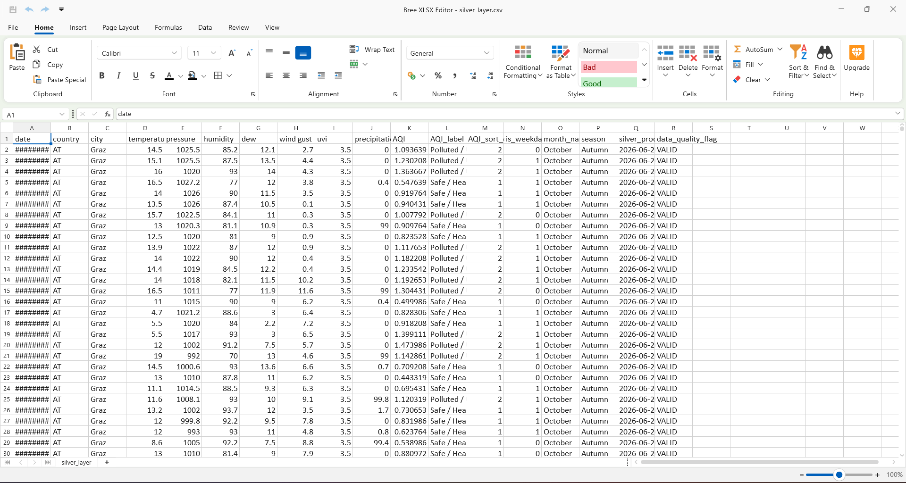
DATA ENGINEERING
The Medallion Architecture
Bronze
Raw pollutant & weather readings ingested as-is from source, preserving full history for traceability.
Silver
Cleaned, de-duplicated, and enriched — temperature, humidity, pressure, dew point, wind, UVI, season and weekday flags, plus a computed AQI label.
Gold
Aggregated, model-ready tables — feature-engineered and validated, feeding both the ML pipeline and the BI dashboard.
Silver layer — cleaned dataset with engineered AQI features (silver_layer.csv)
DATA ENGINEERING
Global Air Quality Analytics & AQI Prediction
04

Slide 5
EXPLORATORY DATA ANALYSIS
Understanding the data before modeling
1
2
3
Data Cleaning
Feature Analysis
Correlation
Handled missing readings, outliers, and inconsistent units across countries before analysis.
Profiled weather and pollutant variables — temperature, humidity, pressure, dew, wind, UVI — for distribution and quality.
Examined relationships between weather variables and AQI to guide feature selection for modeling.
4
5
6
Key Visualizations
Seasonality & Timing
Key Insight
Correlation heatmaps, feature-importance and residual plots generated to validate signal before training.
Compared AQI patterns across seasons and weekdays vs. weekends to capture temporal effects.
Weather conditions carry meaningful signal for AQI — the basis for our feature set going into modeling.
EDA
Global Air Quality Analytics & AQI Prediction
05

Slide 6
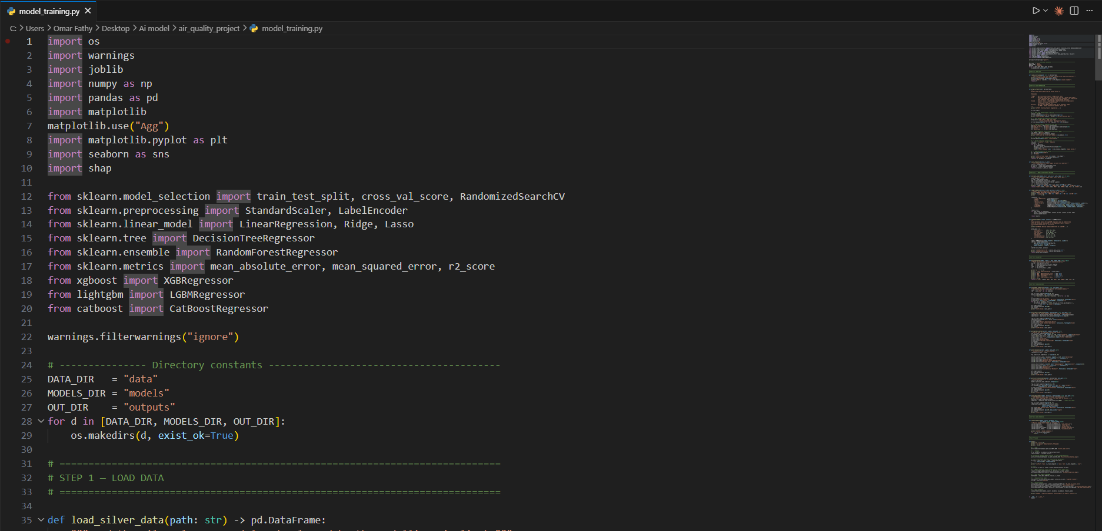
AI / MACHINE LEARNING
Benchmarking models to predict AQI
We trained and cross-validated eight regression approaches on the Silver-layer features, then compared them on R², RMSE and MAE.
Linear Regression
Ridge
Lasso
Decision Tree
Random Forest
XGBoost
LightGBM ✓
CatBoost
Final model selected: LightGBM Regressor — evaluated via cross-validation on R², RMSE, and MAE for the best accuracy/interpretability balance.
model_training.py — model imports & evaluation metrics (R², RMSE, MAE)
MACHINE LEARNING
Global Air Quality Analytics & AQI Prediction
06

Slide 7
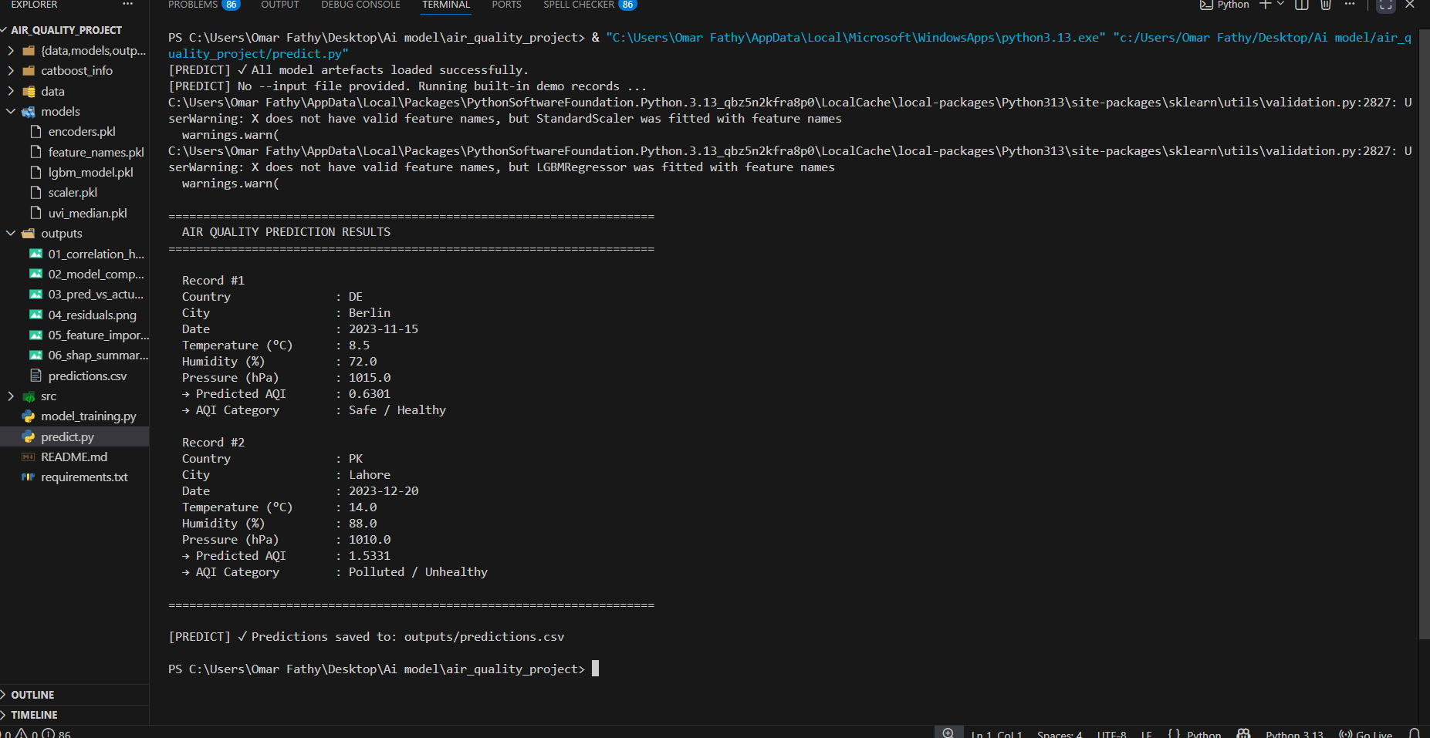
PREDICTION PIPELINE
From raw inputs to an AQI verdict
predict.py loads the trained LightGBM model, scaler and encoders, then scores new weather records and writes results to predictions.csv.
1
Input
Country, city, date, temperature, humidity, pressure
2
Transform
Scaler + encoders apply the same features used in training
3
Predict
LightGBM regressor outputs a continuous AQI score
4
Classify
Score is mapped to Safe / Polluted / Hazardous
predict.py running in VS Code — demo records scored as Safe/Healthy and Polluted/Unhealthy
ML PIPELINE
Global Air Quality Analytics & AQI Prediction
07

Slide 8

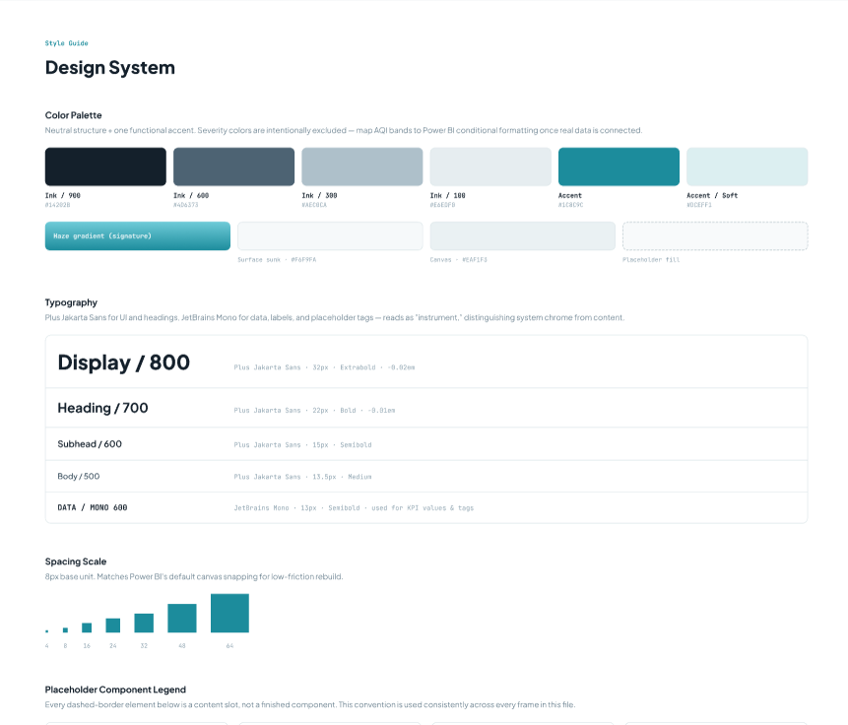
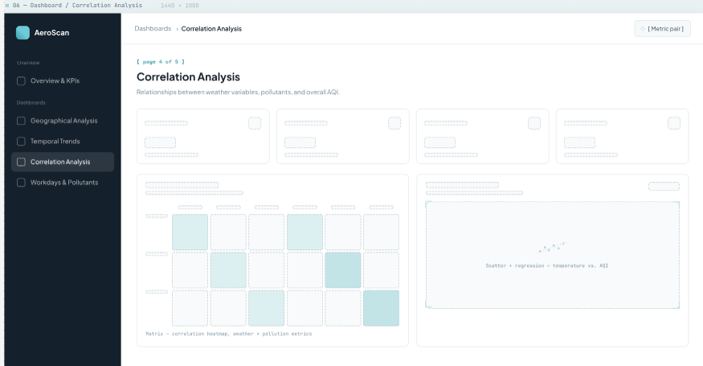
PRODUCT DESIGN
The app the data powers
Alongside the pipeline, we designed a dashboard concept with a consistent design system, ready to be rebuilt in Power BI and wired to live Gold-layer data.
Cover — app design system
Style guide — palette, type & spacing
Correlation Analysis dashboard frame
PRODUCT DESIGN
Global Air Quality Analytics & AQI Prediction
08

Slide 9
RESULTS & INSIGHTS
What the model tells us
The pipeline correctly separates a cool, low-pollution city day from a warmer, high-humidity polluted one — matching domain expectations.
Berlin, Nov
Lahore, Dec
8.5°C
14.0°C
Predicted AQI 0.63
Predicted AQI 1.53
A reproducible artifact set (scaler, encoders, trained model) lets predictions run consistently outside the training environment.
Safe / Healthy
Polluted / Unhealthy
The same Safe / Polluted / Hazardous taxonomy flows from model output through to the dashboard and app UI — one shared language for end users.
RESULTS
Global Air Quality Analytics & AQI Prediction
09

Slide 10
LOOKING AHEAD
Challenges & future work
Challenges & Limitations
Future Improvements
Merging weather and pollutant sources with inconsistent formats and coverage across countries.
Connect the Gold layer directly to a live Power BI dashboard for real-time monitoring.
Demo-scale records so far — accuracy needs validation against larger, real-time feeds.
Expand model coverage with more cities, seasons, and pollutant types.
Feature warnings (e.g. missing feature names at inference) to clean up for production.
Deploy the prediction pipeline as an API behind the app UI.
CHALLENGES
Global Air Quality Analytics & AQI Prediction
10

Slide 11
THANK YOU
Global Air Quality Analytics
& AQI Prediction
Project Team · DEPI Data Analysis Track
Under the supervision of Eng. Mohamed El-Emam
Questions & discussion welcome.

